Slide 1

Celita
Your Cloud Phone
Notes:
If you wish to use this deck - please go to: File -> Download As… and choose (.pptx)
After you got the file, you can upload it and open it with Google slides.
Inspired in this -> https://greenido.wordpress.com/2016/10/19/startup-pitch-deck/ Also, see the notes in some of the slides that will be helpful to direct you in the right path.
The photos on slide #1 and #10 were taken by Ido
You can find our guide to pitching below (with a few refinements from years of use).
Name/Solution Start here: define your Project in a single declarative sentence. This is harder than it looks. It’s easy to get caught up listing features instead of communicating your mission.
Problem Describe the pain of your customer. How is this addressed today and what are the shortcomings to current solutions.
The Value Explain your eureka moment. Why is your value prop unique and compelling? Why will it endure? And where does it go from here?
Solution / Architecture? Provide some guidance / schematics of your solution
Competition / alternatives Who are your direct and indirect competitors. Show that you have a plan to win.
How Much ? If you have estimations about $$$, effort, infraestructure, time please include.

Slide 2

Executive Summary
We provide a landline telephone number with a full PBX with support for multiple users with the simplest & powerful management & analytics tool.
Zero hardware parts, 100% SaaS with a simple qr onboarding process for distributed users.
Notes:
Your executive summary should be bold and impress the reader/listener.
If it doesn’t, they will open their phones and you lost them after the first 2 minutes.
It should contain:
A short explanation on the idea and what you plan to do. Don’t be shy here. After all, you are building something wonderful, right?
What is your competitive advantage? Why you can deliver it and make it happen?
Where you are right now and what you have accomplish so far.
Finish it strong with vision and a few near-term key results you plan to reach.
(!) It’s recommended to have a 1-page version of this slide with more details - So you could send it to potential investors.

Slide 3
The problem
Small a Medium companies have local landline numbers for prospects and customers communications, mostly with single phone or simple PBX systems fixed to his physical installations.
Last worldwide events like: employees working from home or in remote locations, SMB changing their locations, new working models require more flexible systems.
Distributed customers & workforces represent high challenges for information systems to provide tools for analytical.
This require new tools for existings simple communication systems like phone

Slide 4
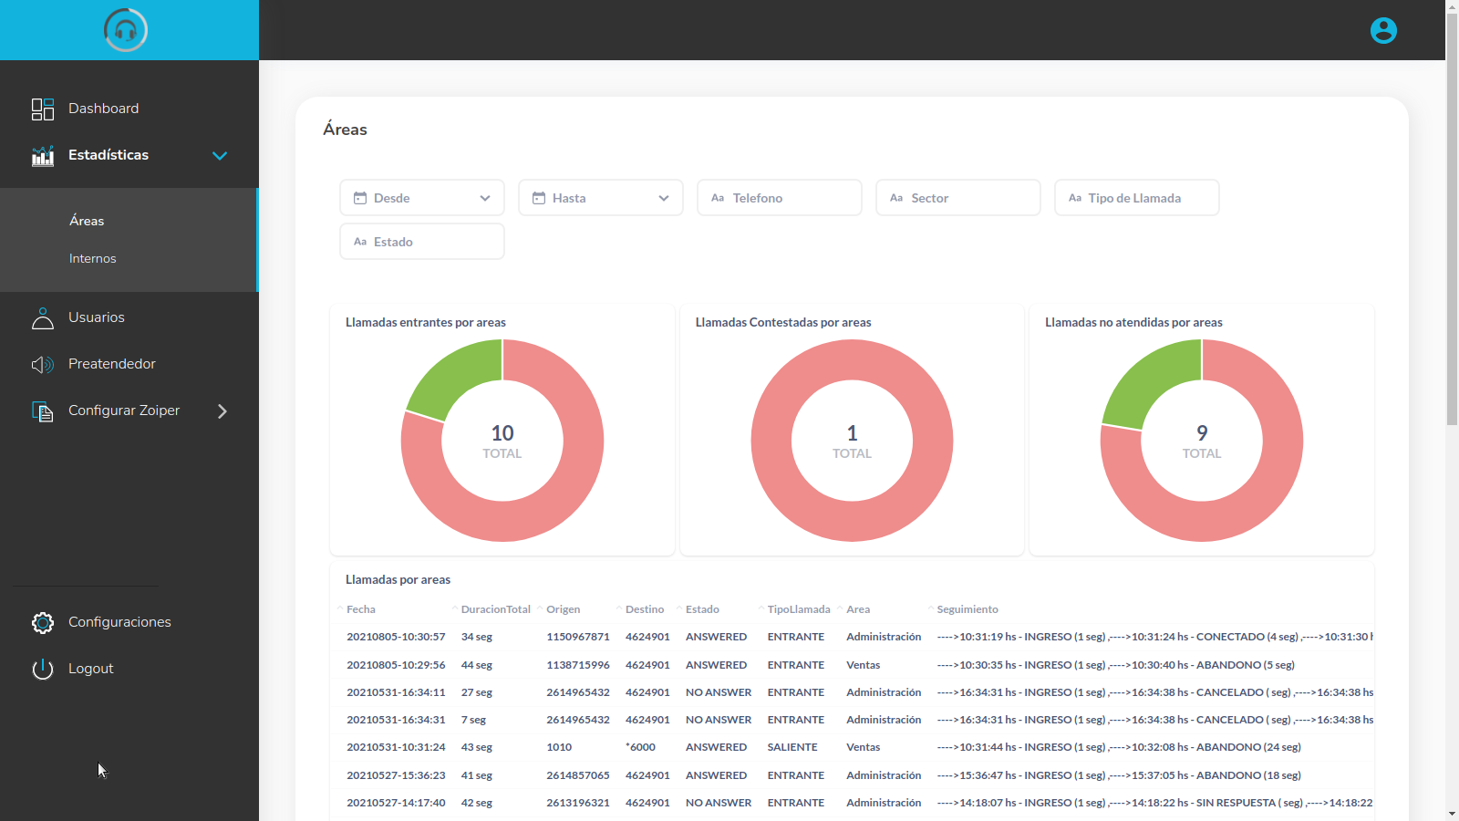
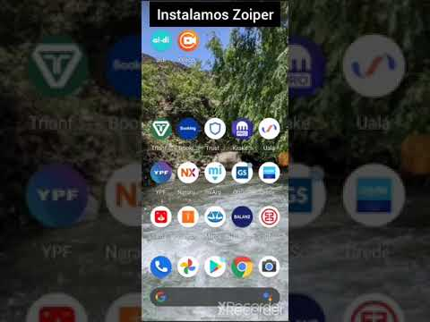
The Value
We provide a 100% SaaS PBX system
Simple management tools, sophisticated features (call queues, CDR BI).
SMB don’t have to invest in any Hardware or infrastructure
Pay as you go service
Flexible to support any working / service model for SMB
Full analytical tool for communications accounting
Automatic & Customizable IVR greetings
Simple qr user configuration !!!

Slide 5
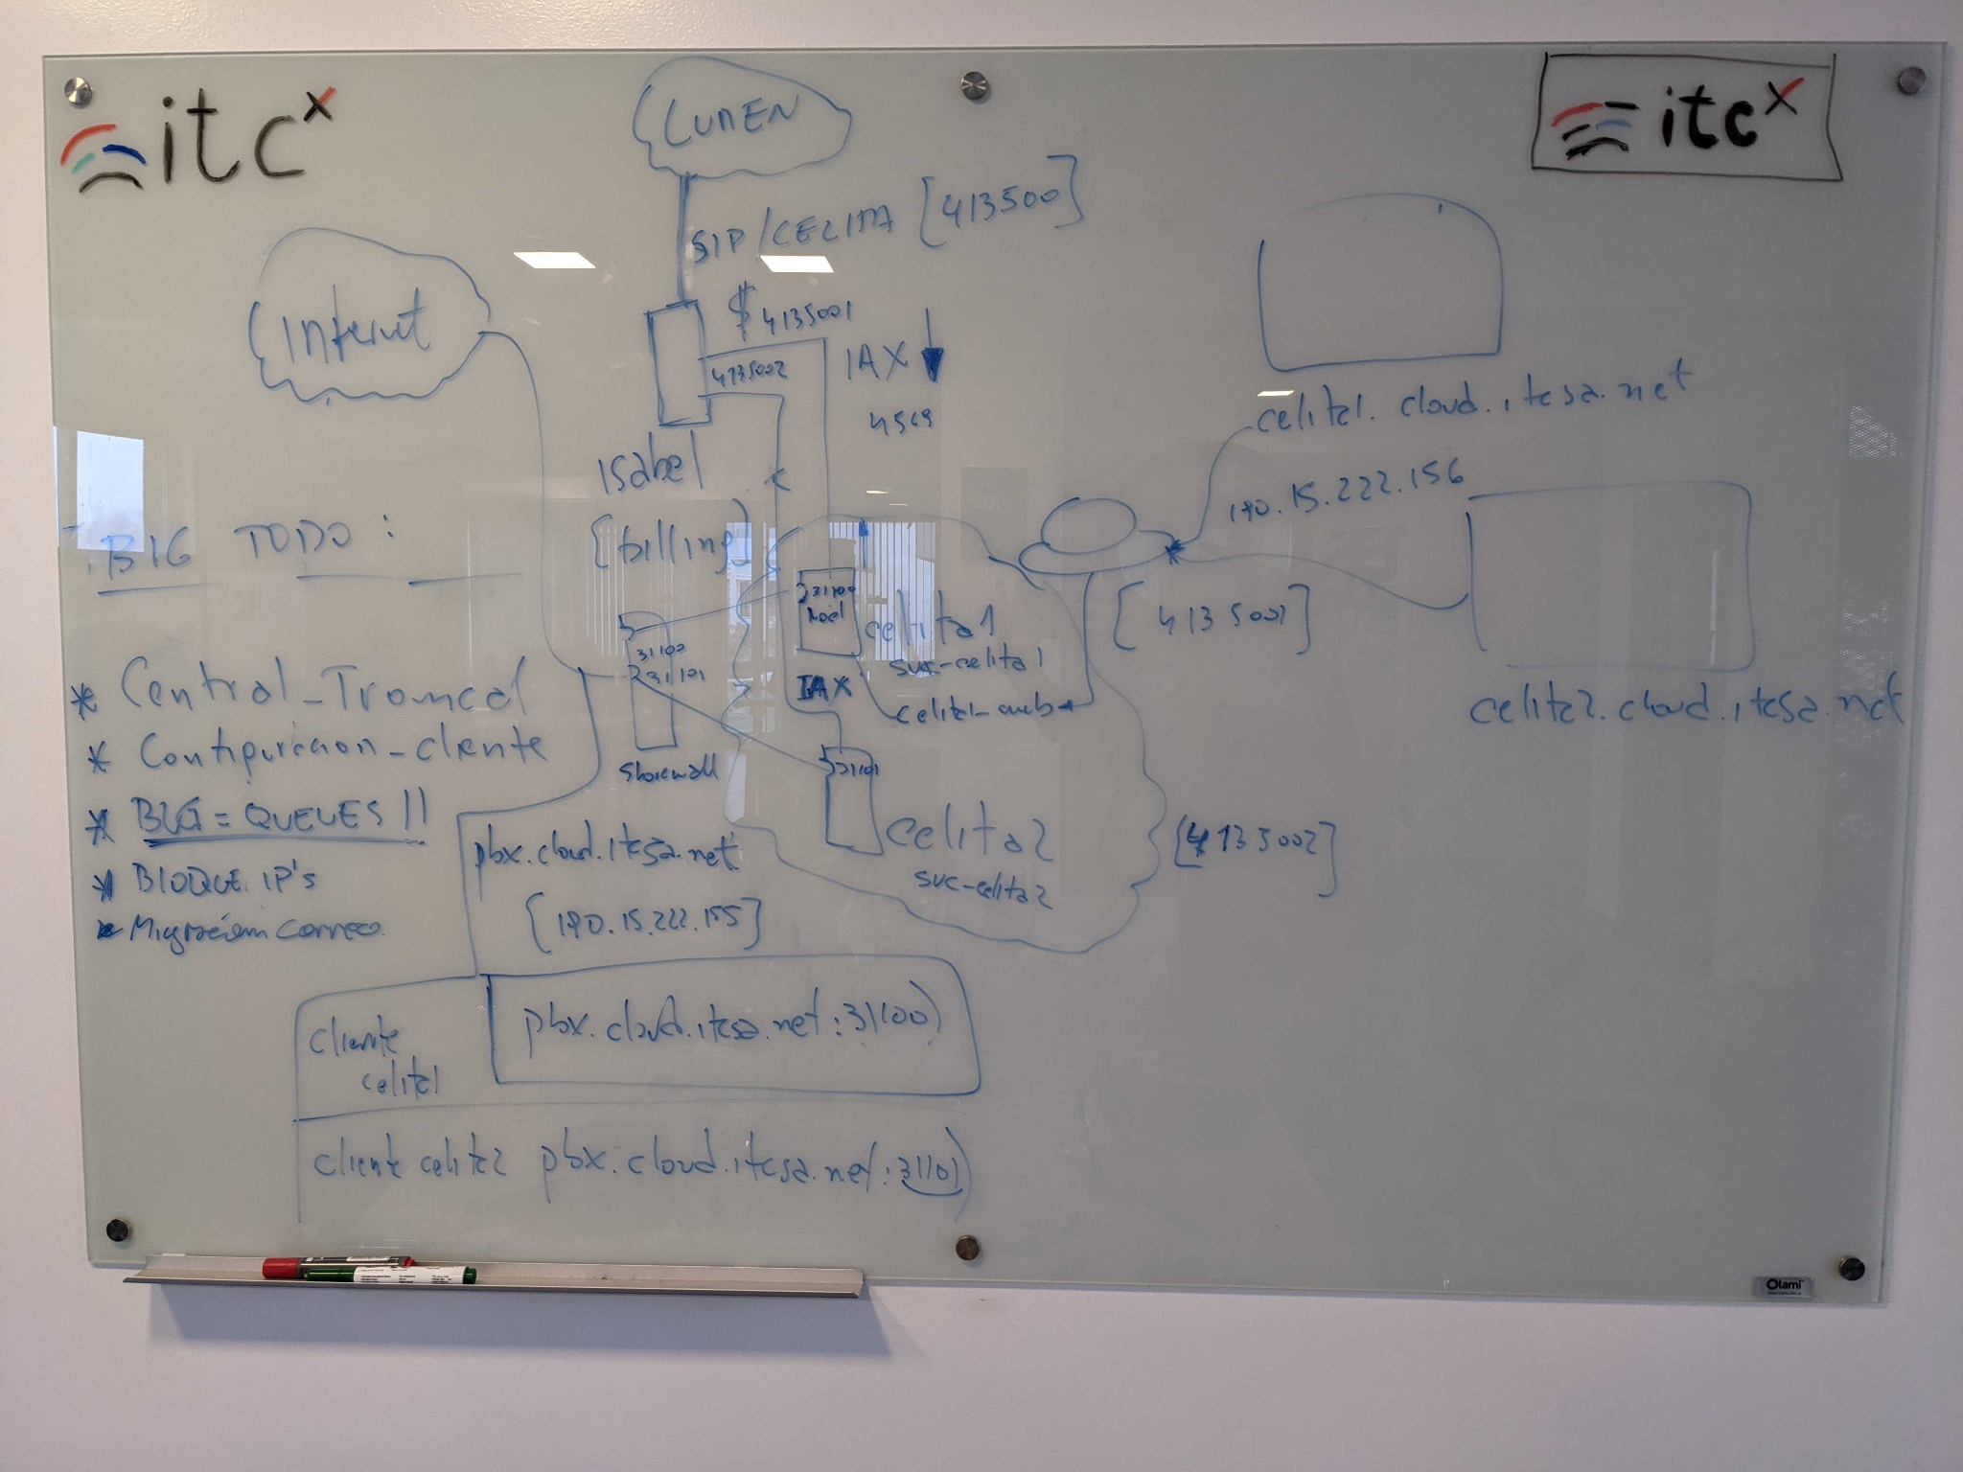
Architecture
SO
kubernetes
Protocols
IAX <-> user
SIP <-> PSTN
HTTP <-> Management
PBX’s (containerized):
Management-FE-BE
Custom Asterisk [DB-backend]
DB-Backend [MySQL]
BI [Metabase]

Slide 6



Competitors
Central Virtual IPLAN
Central Virtual
Central Telefónica
Virtual
Notes:
An overview of what competitors your startup will need to beat.
Here you will build credibility by showing that you are aware of all the major visible competitors and some hidden ones (that will fight with you on the same budget).
(!) A nice chart that shows your strengths and weaknesses vs your competitors is a good way to deliver the message in this slide.

Slide 7
How much ?
Phases
Cluster deployment (0.5 month)
Asterisk Cloud customization (2 month)
Management Front/Back End Development (2 month)
Integration & Test (1 month)
Documentation (1 month)
Resources
Kubernetes 4 node cluster (usd 400 x month)
SIP Trunk (100 landline numbers) (usd 500 x month)
Notes:
Estimations about:
Costs
Time
Infrastructure
...

